Slide 1
ICT SKILL

Slide 2
INTRODUCTION TO ICT
Information Technology means creating, managing, storing and exchanging information. It includes all technologies that can be used to deal with information.
ICT stands for Information and Communication Technology which deals with the use of electronic media like computer, smart phone, iPad, etc. to store, process, and retrieve data or information.

Slide 3
ROLE AND IMPORTANCE OF ICT IN PERSONAL LIFE
Information Technology has become a part of everyday life. ICT applications are found in every field – education, health, business, design, manufacturing, science, environment etc. You can create a project report, do office work, send messages, read books, manage daily planner, play games, listen to music, watch movies, pay bills, book tickets, buy products, and the list is endless.

Slide 4
ICT at Home
A computer can be used at home to play games, search information, listen to music, watch movies, send or receive email, maintain household accounts etc.
A device with internet connection can be used to do online shopping, pay bills, do e-banking etc.

Slide 5
ICT TOOLS
Mobile
Tab
Radio
TV
Email
Laptop
Computer

Slide 6
ICT in education
ICT for education refers to the development of information and communications technology specifically for teaching/learning purposes.
ICT has also become integral to the teaching-learning process. ICT, to some extent, has replaced traditional chalkboards with interactive digital whiteboards. It is used for teaching-learning and assessment. Teaching resources for teachers are available in multiple formats.

Slide 7
ADVANTAGES OF ICT IN EDUCATION
Some of the advantages of ICT in education are:
Complex topics can be easily explained to students with the help of animations, pictures, videos, presentations, etc.
Images and videos used for teaching improve the retention memory of students.
Use of audio-visual aids can make the lessons interesting.
Practical demonstration can be given to the students.
If the teaching process in the class is interactive, it will make the lesson more enjoyable.
An e-learning program allows students to learn at their own pace, at their convenient time, and from any place.

Slide 8
ICT IN HEALTHCARE
ICT plays an important role in healthcare.
Through the right communication media, a doctor can easily suggest treatment and care to the patient who is located far away. Doctor can continuously monitor the patient’s history, diagnostic report, and track the current health condition.
Using the ICT tool or a suitable communication system, government can make efforts to create awareness among the public about the communicable diseases, preventive measures and various current diagnostics etc.
ICT in healthcare research helps to find the possible preventive measures to eradicate and reduce the spread of communicable diseases.

Slide 9
ICT IN HEALTHCARE
Hospitals can use different electronic media to store medical data. This helps to retrieve the information easily. This data can be transferred to the patient or to the doctors for consultation.
Through ICT, the traditional healthcare systems can be refined and new models can be formed for effective quality care.
Computer based machines are used for MRI, CT-scan, ultrasound etc. which are done in hospitals and diagnostic centres to diagnose the diseases.
Life support systems are provided to the patients using ICT based machines.
You can search information on any disease, medicines, etc. on the internet.

Slide 10
ICT in Governance
ICT in governance means using Internet or any other electronic media by the central and state governments, by local administrative bodies to improve efficiency and transparency . Many government services are now available online. Electronic voting for elections has replaced the traditional voting slips to a large extent.
ICT in governance can help:
Deliver government services efficiently
E-governance sites enable people to perform various tasks such as filling a form, applying for passport, paying bills, property tax, etc. even while sitting at home.

Slide 11
ICT in Business
ICT in business can be used for many purposes like:
Keeping records of the stock
Preparing accounts and balance sheets
Maintaining database of staff and customers
E-commerce enables people to buy and sell products online. This service can be made available 24 x 7.
E-banking facility helps to make banking transactions at any time of the day.

Slide 12
Impact of ICT on society
ICT has affected the society in both positive and negative ways. We have already discussed the use of ICT in various fields.
ICT has divided the society into two groups:
1. People who can do their personal and professional work efficiently. They are efficient in using services like, e-banking, e-learning, e-governance sites, etc.
2. People who do not have access to a computer and internet. They also do not have knowledge to use facilities available on the internet.
This has resulted in digital divide, which refers to the gap between people who have access to latest information technologies, like, computer, smart phones, internet, ipad, etc. and have knowledge to use them and people who do not have access to use these devices.

Slide 13
ICT in our daily life (examples)
ICT has a great impact in our daily life. Some of the uses of ICT in our daily life are given below:
• We can read newspapers online.
• We can get connected with our friends, relatives or even family members far away from us using email, messenger, video conferencing etc.
• With the introduction of video conferencing, business meetings have now become easier.
• Nowadays people use mobile phone apps to meet and connect with new and old friends.

Slide 14
ICT in our daily life (examples)
Social networking sites like Facebook.com have played a big role in connecting both old and new relationships.
We can access a full library of educational material via mobile app or website on any smartphone or iPad.
Technology has also made the buying and selling of goods and services flexible and a lot safer.
Most banks now offer online banking facilities. People make use of this service daily to manage their finances.
Most businesses use online banking facility to pay employees/ vendors and transfer money to their bank accounts.

Slide 15
IDENTIFY THE VARIOUS COMPONENTS OF COMPUTER SYSTEM
BASIC COMPONENTS OF COMPUTER SYSTEM
HARDWARE AND SOFTWARE
  Computer hardware – Physical parts of a computer such as Input devices, output devices,central processing unit and storage devices are called computer hardware.
  Computer software – Software are the programs or applications that run on computer. For example, MS Word, MS PowerPoint, Operating systems, etc.

Slide 16
COMPUTER HARDWARE
The physical components of a computer system are called hardware. A computer basically consists of following physical components:
• Input unit
• Processing unit
• Storage unit
• Auxiliary storage
• Output unit

Slide 17
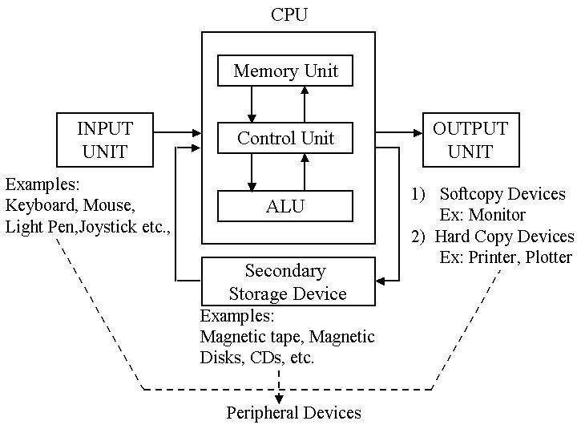

Slide 18
Input Devices
Central Processing Unit (CPU)
Input devices are used for entering data or instructions into the computer. Eg. Keyboard, virtual keyboard, mouse, touch screen etc.
The Central Processing Unit is the brain of the computer system.

Slide 19
Functions of Central Processing Unit :
It controls the sequence of operations within the computer
It gives commands to other parts of the computer
It controls the use of main memory for storing data and instructions
It consists of the following main units:
Arithmetic and Logic unit (ALU)
Control Unit (CU)
Main Memory Unit

Slide 20
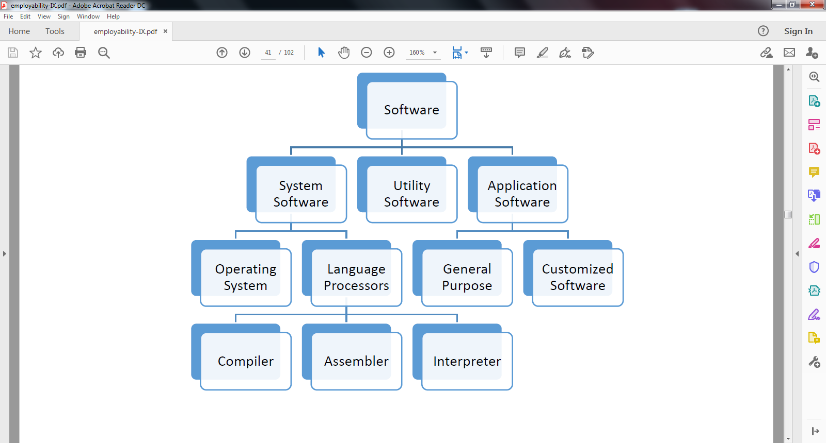
Software
Software is a set of computer programs that perform a particular task.
Following are the categories of software:

Slide 21
System Software
System software is a set of one or more programs designed to control the operation of a computer system.
Operating systems and language processors come under the category of system software.
Operating System
Operating system is a master control program that runs the computer. When computer is
switched on, operating system is the first program loaded into the computer’s memory.
Examples of operating system are Windows, UNIX, MS-DOS, Mac OS, Solaris, etc.

Slide 22
Language Processors
A computer understands instructions in the form of machine code, i.e., 0 and 1. The programs are written in English like high level language called source code. The source code must be converted into machine language in order to execute. The translator program that is used to convert source program written in high level language to machine code is called language processor. The program translated into machine code is called the object program.
Language processor is of three types:
1. Assembler:- It is a program that translates an assembly language program into machine language.
2. Compiler:-It is a program that translates a high-level language program into machine language. For example C++ compiler.
3. Interpreter:-It is a program that translates a high-level language into machine language program line by line. For example, Visual basic Interpreter.

Slide 23
Application Software
Application software is a computer program that is designed to perform a certain type of work. This type of software pertains to one specific application. For example, software written to calculate salary of the school employees cannot be used to prepare school result.
Application software can be classified as General purpose software and Specific purpose application software.
General purpose application software includes word processing software like, Microsoft Word, spreadsheet software like, Microsoft Excel, etc.
Specific Purpose Application software
Specific purpose application software are the software that perform particular task. Examples of specific purpose application software are Accounting management software, Reservation system, Payroll software etc.

Slide 24
Utility Program
A utility program is used to perform maintenance work on a system or on the components of computer.
Examples of Utility program are- anti-virus software, file management programs, etc.
Antivirus software:- This program helps in detecting and removing viruses. For example, Norton antivirus, McAffee virus scan etc.
File management tools:-These tools help in storing, searching, and sorting files and folders on the system. For example, Windows Explorer, Firefox etc.
Compression:- This program helps in compression of large files so that they take less storage space. For example, WinZip, Win RAR etc.

Slide 25
Disk Management Tools
These programs include
Disk Cleaner:-This utility scans for the files that have not been used since long. These files may be occupying large amount of space. It prompts the user to delete such files to create more disk space.
Disk Defragmenter:-It rearranges the files and free space on the computer so that files are stored in contiguous and free space, . consolidated in one contiguous block. This speeds up the disk access.
Backup:- backup means making a duplicate of the files and data stored on the computer. This program is used to take backup copy of the data. In case the original data is lost, the back up data can be used which can help in restoring data till the last back up date.

Slide 26
BASIC COMPUTER OPERATIONS
Starting and shutting down of computer.
Operating System
Types of O/S- (DOS, Windows and Linux)
  Time Sharing
  Multiprocessing
  Multi user
  GUI
Desktop of Windows and linux

Slide 27
FILES AND FOLDERS
KEYBOARD AND MOUSE OPERATION
COMMON DESKTOP OPERATIONS

Slide 28
INTERNET
INTRODUCTION
INTERNET APPLICATIONS
INTERNET BROWSER
WEBSITE & WEB PAGES
EMAIL APPLICATIONS
EMAIL ACCOUNTS
SENDING AND RECEIVING EMAIL

Slide 29
SOCIAL MEDIA
BLOG
TWITTER
FACEBOOK
YOUTUBE
WHATS APP
INSTAGRAM
ETC

Slide 30
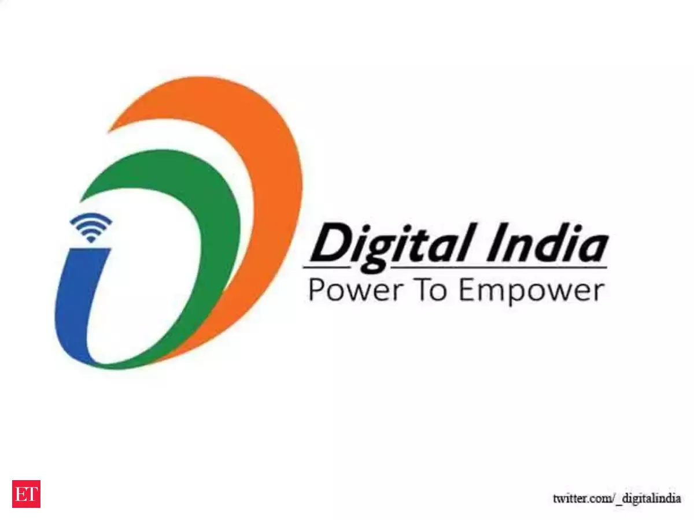
DIGITAL INDIA
Digital India is a campaign launched by the Government of India in order to ensure the Government's services are made available to citizens electronically by improved online infrastructure and by increasing Internet connectivity or making the country digitally empowered in the field of technology.
Launch year: 2015

